Slide 1
STAR 6-Gold Evaluator/Coach Assessor Energizer
Reaghan Fawcett & Brett Hines
Notes:
75 minutes
Introduce ourselves – Energetic / positive....
Break ice – about the change in the evaluating system.... 29 years ....Graduated from high school - graduated from High School.... Brett on Elementary badge....
Who can forget what a big change that was at the time. We went from the engrained 3 judges / test – often in mandatory fur coats.... carrying their clipboards on the ice...... But the vibe definitely changed. Test Days became a little less "scary" with move to 1:1, easier to staff & manage, more focus on the positive aspects.... We got rid of the F word... "FAIL".
Now we are undergoing a similar monumental shift. Other than the replacement of figures with skating skills, and a some minor modifications – things have stayed mostly the same for almost 3 decades.
UNTIL NOW!
It is so exciting that we are finally going to have some much needed updates to our system of testing/assessing.

Slide 2
KAHOOT
Go to kahoot.it
Enter Game Pin
Create your game name
Notes:
True or False questions,
Rumours, concerns type questions (is this a rumour or a concern?) …. CREATE QUESTIONS
Coaches can assess all assessments across all disciplines in STAR 6-Gold
…
…

Slide 3
WHAT’S THE WORD?
Artistic
Skating Dev. Video Library
Assessment
Assessment Coordinator
Gold Rhythm Dance
Continuum of Development
Figure Form
Materials Catalogue
Lead/Follow
Qualified Evaluator
« For the Level »
Simple Black
Resource Guide
Skating Exercise
SPREAD THE WORD
Notes:
Skate Canada is introducing new vocabulary with the launch of 6-Gold so you’ll be hearing new words that you may not have heard before, or old words that were once used… Let’s take a look at some of these
Ask audience to describe what they think these terms mean in the 6-Gold context or have them identify why they might be important (prizes?)
Continuum of Development = Brand New!
Assessment = Test
Gold Rhythm Dance = Brand New!
Figure Form = Bringing this philosophy back!
Lead/Follow = male steps and female steps in dance
For the level = concept brought on through the Continuum of development
Skating Development Video Library = Skate Canada has a video library available on YouTube where you can go to find out latest updates on new dances, practice your skills as an official, etc.
Assessment Coordinator = Test Chair
Artistic = Interpretive (though they don’t look the same anymore)
Resource Guide = Brand New or revising what we termed Manuals, guides, resources…
Materials Catalogue= our new page where you can go to get program and event related material (For officials, this means that resource guide we mentioned before, officials sheets will soon be available here…)
Qualified Evaluator = we use to call evaluators by which level they could evaluate (JB, SB, SS, Gold), now there is only one qualification by discipline.
Simple Black = eliminating artistic costume that take away from focus of skater’s ability to interpret the music (only in Artistic Assessments)
Skating Exercises = Stroking

Slide 4
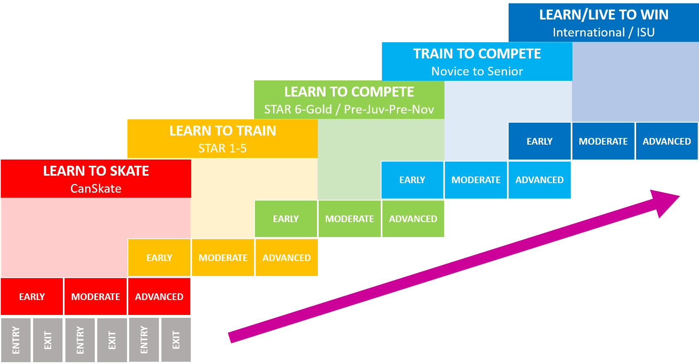
Continuum of Development + LTD
Stages of development builds into the next
Clearer expectations of what must be demonstrated at each level
LTD
COD
Notes:
LTD = Long Term Development (formerly LTAD) COD = Continuum of Development (3 stages; Early, Moderate, Advanced with an Entry and Exit Phase)

Slide 5
STAR 6-Gold Training
Coaches and evaluators complete the same training!
Training will be online for easy access by all stakeholders!
Available Now!
STAR 6-Gold Training: Introduction
Skills
Artistic
Freeskate
Dance
Notes:
Launch date of STAR 6-Gold September 1 (hard date)
1. Announce Introduction now available....drum roll/applause!
2. Take people to the e-learning site to show them where to access
3. Re: Other modules.....they are coming! Skills mostly complete
4. have decided to realease in this order because Skills & Artistic have the most content changing.
5. For Freeskate and Dance.....continue teaching freeskate and dance.... Status quo – keep on keepin on. ..... teach an Axel … teach the Paso..... teach the combination spins. These will all be included in the new structure.
Content is coming to help you with this transition:
How to learn Cha Cha
Workshops happened on Artistic and Gold Rhythm Dance.
Finally – BIGGEST NEWS - for the first time evaluators and coaches will be completing the same training!

Slide 6
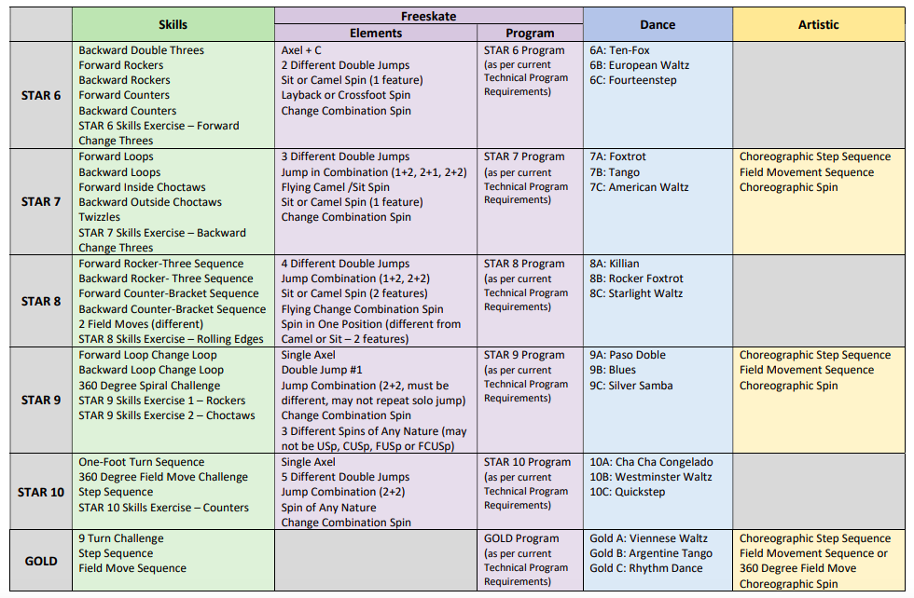
STAR 6-Gold Assessment Content
Notes:
HOW CHART WITH CONTENT
Freeskate PROGRAM content will match the existing STAR 6-Gold free skate content. Any changes to this will be reflected on the test.
Freeskate ELEMENTS have been communicated...consult Assessment Overview
Dance – Creative Dances at each level no longer.
Dance groupings have changed based on feedback from dance coaches. All levels have 3 dances – consult Assessment Overview
Skills - Sneak peak of exercises for skills are already available. SHOW them the e-learning site.

Slide 7
Training Pathway for Coaches
Coach Training
STAR 6-Gold Training: Introduction eLearning Course
Coach Trained
STAR 6-Gold Training Modules + Exam
(per Discipline)
Coach Assessor for Skills
*The coach’s skaters only
Coach Trained
Coach Assessor for Skills
Mentored Assessment
Notes:
Talk about rational: why we are allowing coaches to assess skills.
Need to confirm if the coach assessor Mentored Assessment is staying in the pathway
AT notes: To be a coach assessor in STAR 6-Gold, need to also have completed STAR 1-5 coach assessor training. And YES mentored assessment will be staying.

Slide 8
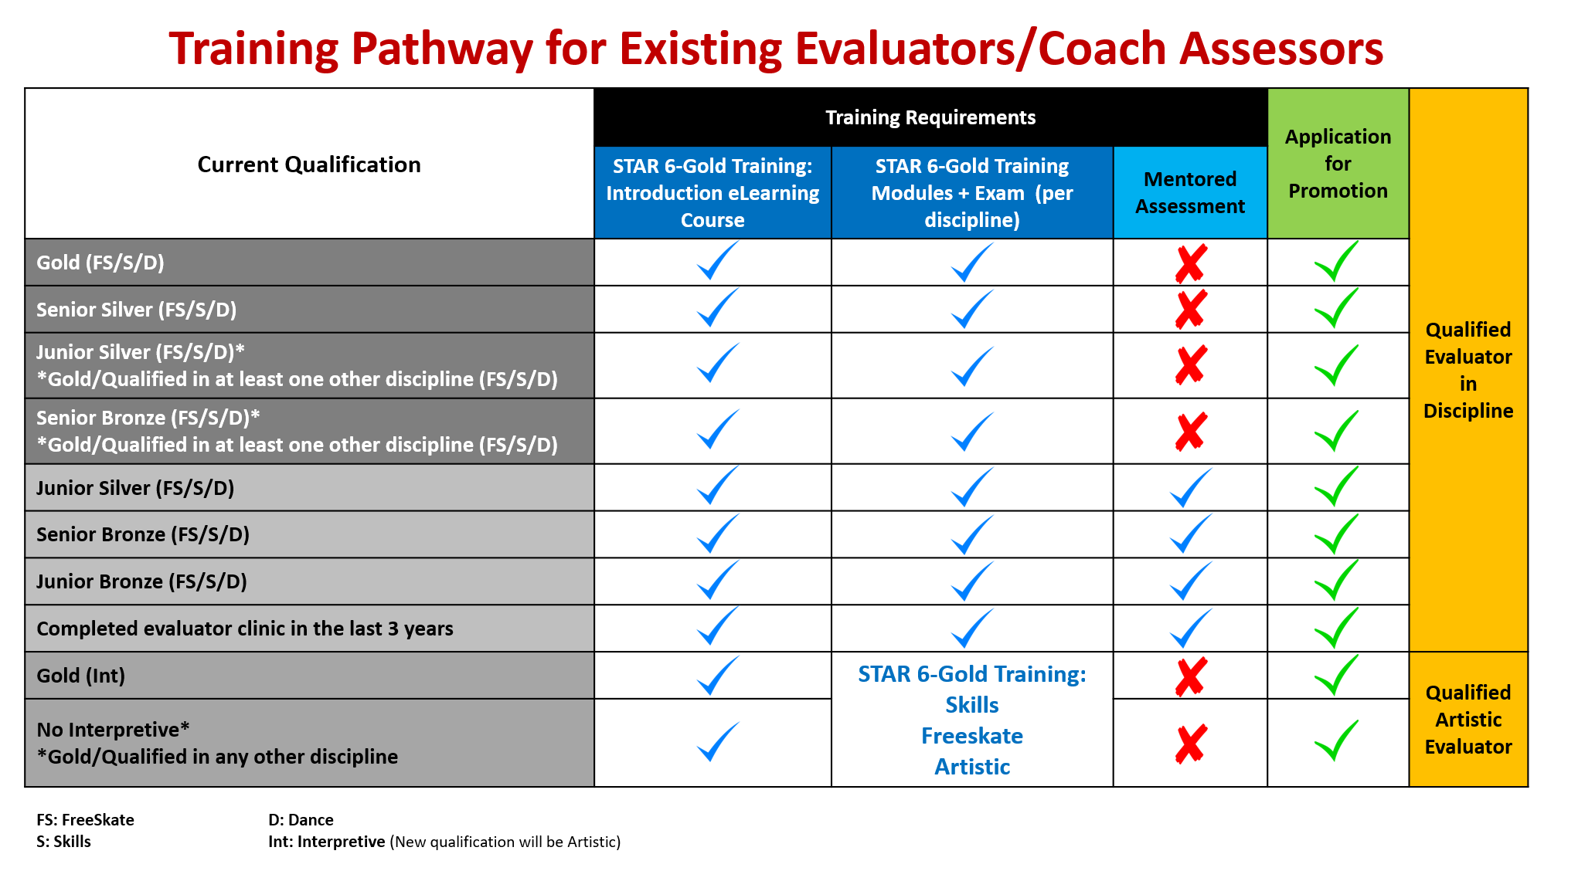
Training Pathway for Evaluators
Notes:
Rule of Thumb : if a current evaluator has ZERO qualifications at the Senior Silver or Gold level, then they will need to complete a mentored assessment.

Slide 9
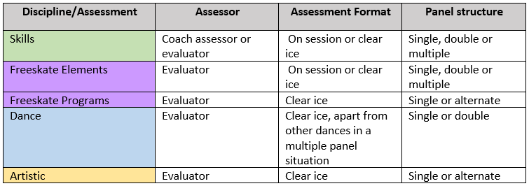
Assessment Structure Review
Definition of Clear Ice – Only the skater being assessed is actively skating on the ice. This may be on a regular session, with other skaters standing along the boards or in the players box, or on a traditional assessment day format.
Notes:
Review different formats for assessments.
Re-visit single panel, double and multiple; what they look like, what they are
Discuss assessing on session and definition of clear ice.
Discuss assessments as part of competition – Brett

Slide 10
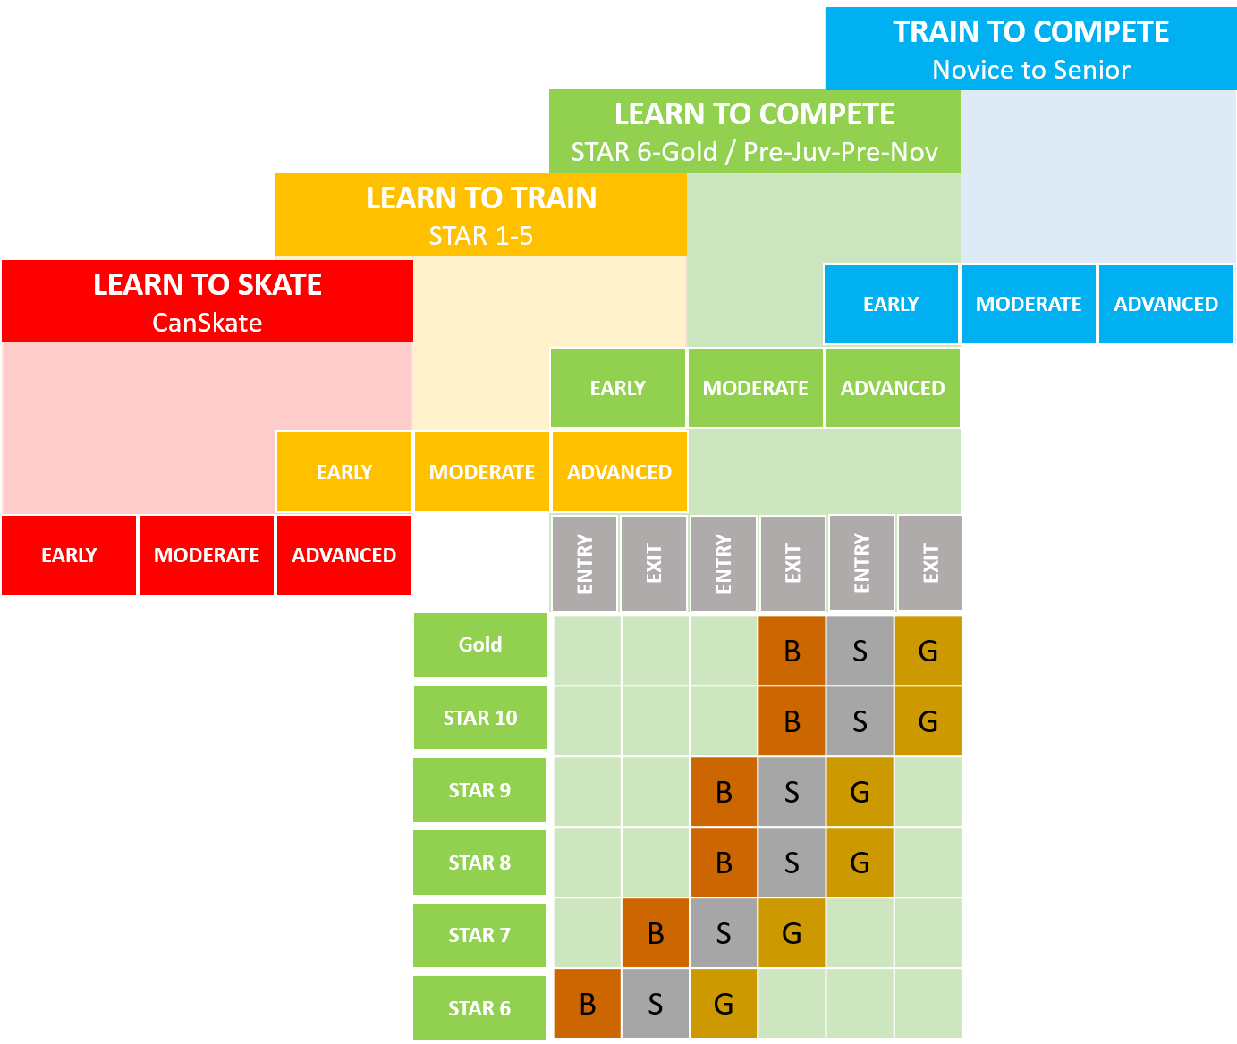
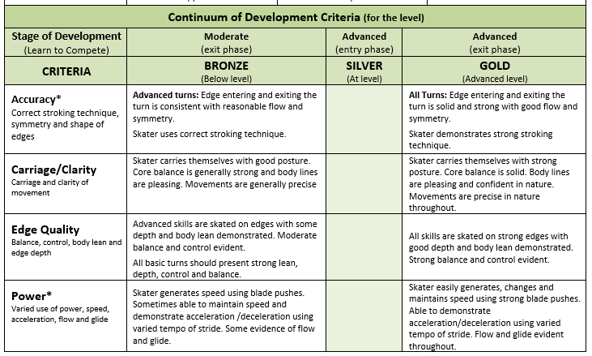
Continuum of Development
STAR 6-Gold – Closer Look
Notes:
Provide Participants with paper version of the Full Continuum
Early-Moderate-Advanced
Entry-Exit phase
B-S-G

Slide 11
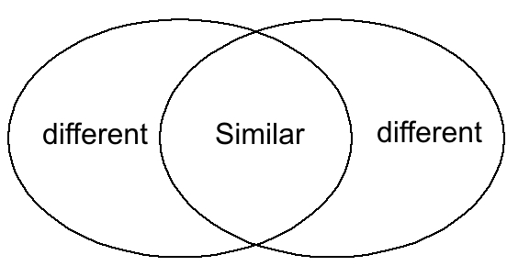
Activity 1: Assessment Sheets
With your table
Review the assessments sheets you have been given
List 3 similarities and 3 differences that you see between the new assessment sheets and the existing test sheets.
Notes:
Each table has assessment sheets from each discipline and they are to list/discover similarities and differences

Slide 12
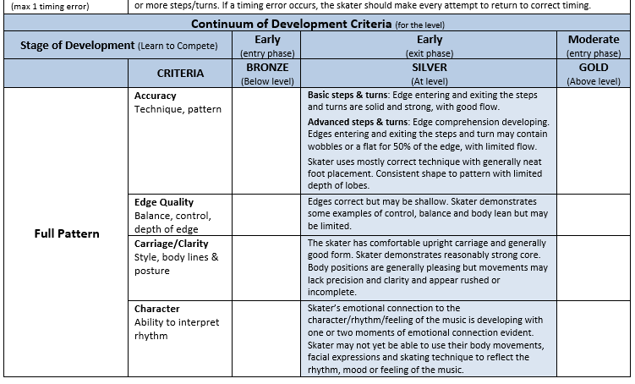
Activity 1: Assessment Sheets
Advantages of the assessment sheet:
Pass with Honours
Assessment Criteria
Continuum of Development
Notes:
Debrief from activity: Highliting all advantages of assessments sheets
Pass with honours,
criteria…
Reaghan: Look at assessment sheets for ideas

Slide 13
Complexity
Skills are introduced earlier:
Facilitates mastery of skill as skater moves through STAR levels
Allows skaters to have skills in development assessed
Allows Evaluators to understand continuum of development as it applies to skill development
Notes:
Complexity: skills are introduced earlier = evaluating skills in development
Relate to Back spin and sit spin in STAR

Slide 14
Example of Complexity Progression
Notes:
Complexity: skills are introduced earlier = evaluating skills in development – show/insert Rocker video
Relate to Back spin and sit spin in STAR

Slide 15
Resources
Where to go for more information?
www.skatecanada.ca/e-learning
On-line training courses
Info Centre
STAR 6 – Gold Resource Guide
STAR 6 -Gold Standards Videos
STAR 6- Gold Assessment Sheets
Dance Patterns
And more!
Notes:
A discussion on where everyone can go to find information, PRACTICE, read, discuss, view, etc.

Slide 16
Questions
Notes:
Question and answer Activity.
Write down your Top 3 for each:
1. Most positive aspects of the new STAR 6-Gold system
2. Remaining questions about the STAR 6-Gold system

Slide 17
Show of Thumbs!
How are you feeling about STAR 6 – Gold Assessments?
Notes:
Show of thumbs!
How are you feeling about STAR 6-Gold
I’m ready for the launch
I’m terrified/scared
I won’t be touching this until September
I’m doing ok
Make this a show of thumbs!
Which colour represents FreeSkate:
Purple
Blue
Green
I didn’t know Freeskate had a colour

