Slide 1
LGBTQI2S Inclusion & Skate Canada
Rosie Cossar, Canadian Olympic Committee
Dr. William Bridel, University of Calgary

Slide 2
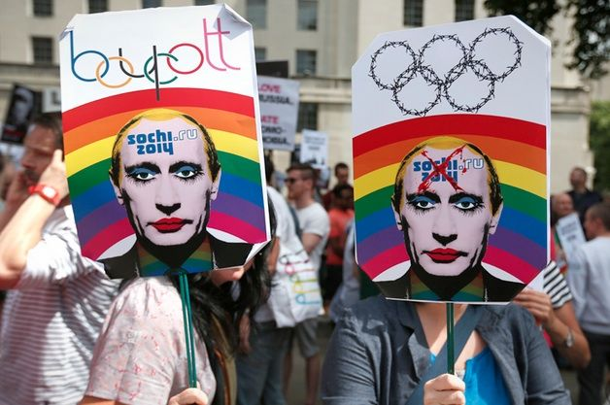
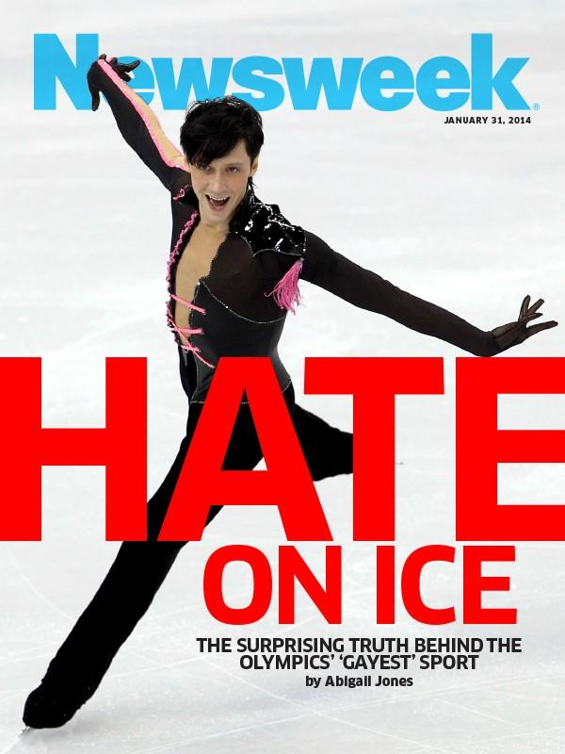
Notes:
William to talk briefly about LGBTQI2S issues in sport brought to the forefront leading up to the 2014 Olympic Winter Games
But
~30 years of research on LGBGTQI2S athletes & sport
Majority has focused on L and G coaches & athletes
But, newer research emerging on trans and genderqueer kids and elite athletes

Slide 3
What We Know
LGBTQI2S persons
Face barriers in youth sport that cause high drop-out rates
Drop out of sports more frequently than heterosexual and cisgender peers or feel that medical interventions are necessary to continue participation
Experience social isolation if they remain in “toxic” sport environment
Present coming out as having “gone better” than they anticipated

Slide 4
What We Know
LGBTQI2S persons
Find more acceptance when they have “athletic capital”
Experience improved performance after coming out
Wished they had more role models when they were younger
Have considered, attempted, or died by suicide
Are feeling more welcome in sport, but there remains much work to be done
Notes:
Out on the Fields (Denison & Kitchen, 2016)
81% of Canadian participants witnessed or experienced homophobia in sports
70% of Canadian participants believe youth team sports are not welcoming for LGB persons
66% of Canadian participants felt that an openly LGB person would not be safe as a spectator at a sporting event
Barriers to participation for trans and non-binary kids in recreational sport in Canada (Travers, 2016)
Potentially toxic environments in sport and physical activity spaces
Issues of access related to the fact that many sport programs and facilities are sex-segregated
Differentiation of activities based on sex stereotypes even within gender integrated (i.e, “co-ed”) sports

Slide 5
Terminology
The initialism: LGBTQI2S
Lesbian
Gay
Bisexual
Trans
Queer
Intersex
Two-spirit
Notes:
Two-spirit is an indigenous identity that does not fit into Western perspectives on gender identity and sexual orientation
Spiritual component
This identity can only be held by indigenous/ First Nations persons and does not correspond directly to any white/Western definitions of LGBTQ identity

Slide 6
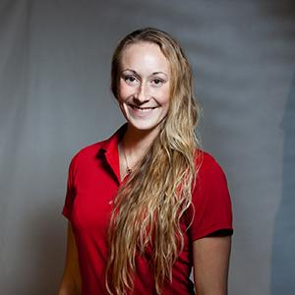
Rosie’s Story
2012 Olympian
Consultant, Sport Inclusion
Canadian Olympic Committee
LGBTQI2S SITF

Slide 8
Rosie’s Story
2012 Olympian
Consultant, Sport Inclusion
Canadian Olympic Committee
LGBTQI2S SITF

Slide 9
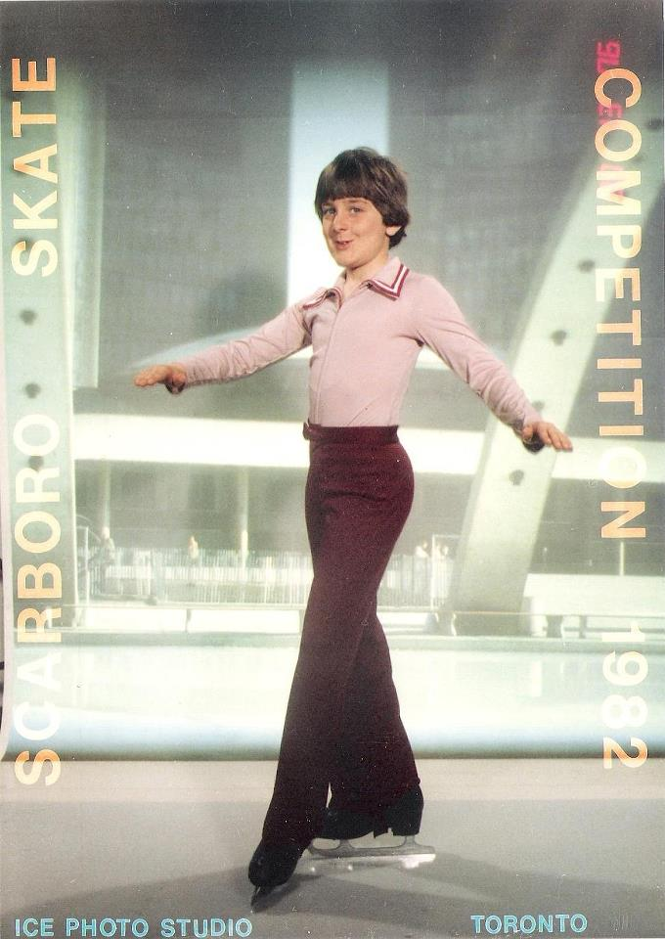
William’s Story: The Past
Sissy
Queer
Silence
Faggot

Slide 10
Our Stories: The Present, The Future
Compassion
Empowerment
Inclusion
Respect
Empathy
Diversity

Slide 11
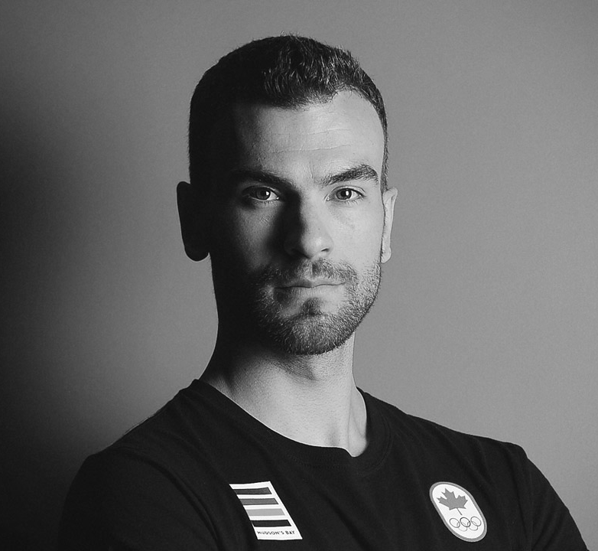
Skate Canada’s Story
Skating’s history is not one of openness, inclusion
But, the narrative is shifting!
Skate Canada’s commitment to Safe Sport
Inclusion as a necessary component of Safe Sport

Slide 12
Skate Canada’s Story
Steps to date:
Updated policy statements including gender identity and gender expression
Revised—and more inclusive—Code of Ethics

Slide 13
Skate Canada’s Story
Steps to date:
Educational resources available online for members (English and French, sport-specific and more general)
Inclusion training for National Service Centre Staff
Trans inclusion policy

Slide 14
Skate Canada’s Story
Moving forward:
Review of rulebook, policies/procedures, etc.
Interviews with LGBTQI2S persons in the organization
Survey of membership
Observation of skating competitions

Slide 15
Available Resources
CAAWS “Leading the Way” webinar
CCES “Creating Inclusive Environments for Trans Participants in Sport…”
COC’s #OneTeam program/resources
You Can Play Ambassadors

Slide 16
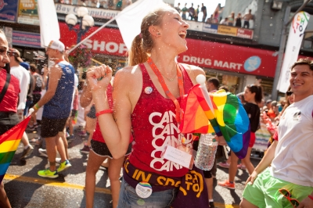
Rosie’s Final Thoughts

Slide 17
Questions?

